Slide 1
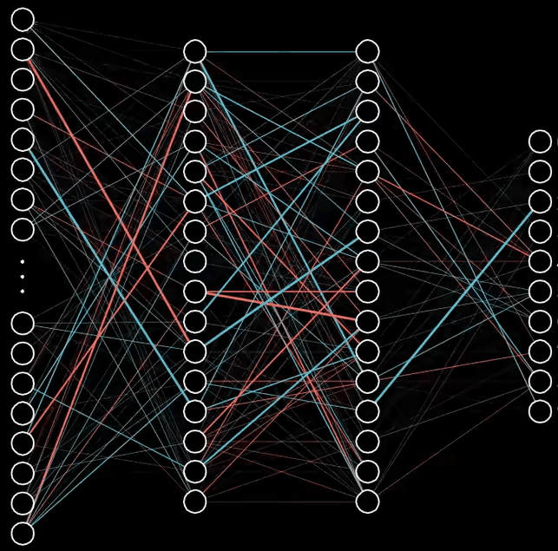
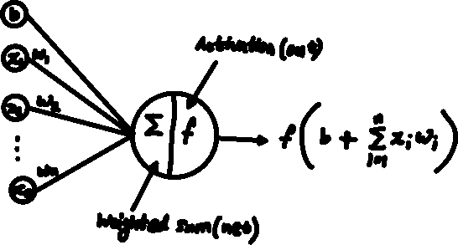
Artificial Neural Network (ANN)
Input Layer
Hidden Layers
Output Layer
Source: Blue3Brown

Slide 2
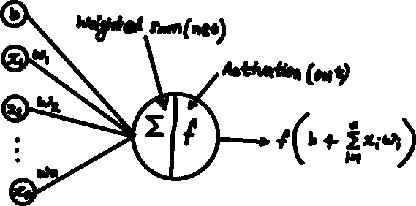

Slide 3
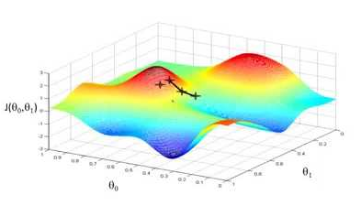
Terminologies:
Weights and Biases
Control the signal/ strength of the connection between the neurons
They are the coefficients of the functions formed within the network
Forward Propagation
It is the way of performing the computation stating from the input data witch progress through each layers
Loss / Cost Function
It is a function of weights and biases that compares the target and predicted output
Measures how well the network models the training data
Backpropagation
Process of minimizing the total error by finding the minima of the loss function
Calculate the contribution (gradient) of each weight and biases to the total error in every layer
Uses gradient descent to optimize the weights and biases to minimize the total error in the network
Gradient descent
Optimization algorithm which identifies the minima of the loss function
Find the gradient (direction vector) of the function
update the parameters (weights and biases) on a small step (as per the learning rate)

Slide 5
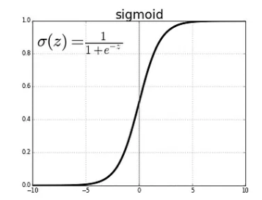
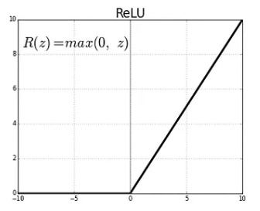
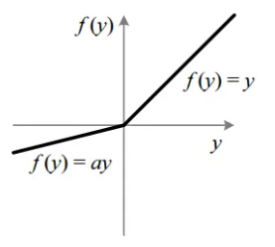

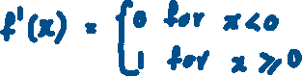
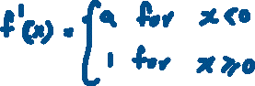

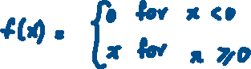
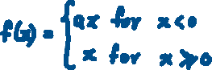
Activation functions
Activation functions adds non-linearity to the neuron computed with linear “weighted sums”
Helps model to adapt with variety of data
Sigmoid: Transforms the input value to a range between 0 and +1 (used when the layer need to predict probabilities)
Relu: widely used in CNN networks, range:[0 to +infinity)
Leaky ReLU: Increases the range of ReLU, range: (-infinity to +infinity)
Leaky ReLU

Slide 6






Loss Functions
Regression Loss Functions
Used in Regression Neural Networks – Given an input value, model predicts the corresponding output value
Loss functions: Mean Squared Error (MSE), Mean Absolute Error (MAE)
Classification Loss Functions
Used in Classification Neural Networks – Given an input, ANN produces a vector of probabilities that belong to various pre-set categories. Select the category based on the highest probability at its corresponding index
Loss functions: Binary Cross-Entropy (BCE), Categorical Cross-Entropy (CE)
MSE Loss
MAE Loss
BCE Loss
CCE Loss

Slide 8

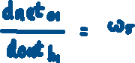

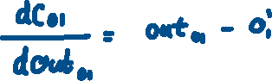


Slide 9



Similarly, on the entire network
Compute the derivative of all the weights and biases wrt cost function
Update the weights on each iteration (epochs) with the learning rate

Slide 10
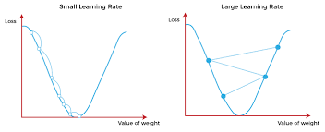


Gradient Descent
Apply Backpropagation and compute the gradient of weights and biases wrt overall cost
Update the weights and biases which minimizes the cost
Vanila Gradient descent:
Stochastic Gradient descent:
Calculates Gradient for one observation picked at random, instead of calculating the gradient for the entire dataset
It is faster as compared to "Gradient Descent"

Slide 11

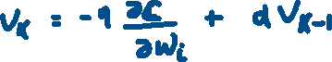
Gradient Descent
Momentum Gradient descent:
It incorporates information from the previous weight updates which helps to converge quickly
RMSprop Gradient descent:
Learning rate is adjusted based on moving average of the squared gradient
Helps algorithm to converge faster in the presence of noisy gradients
Adam
Combines Momentum and RMSprop as the learning rate is adaptively adjusted for each parameter based on moving average of the squared gradient

Slide 12
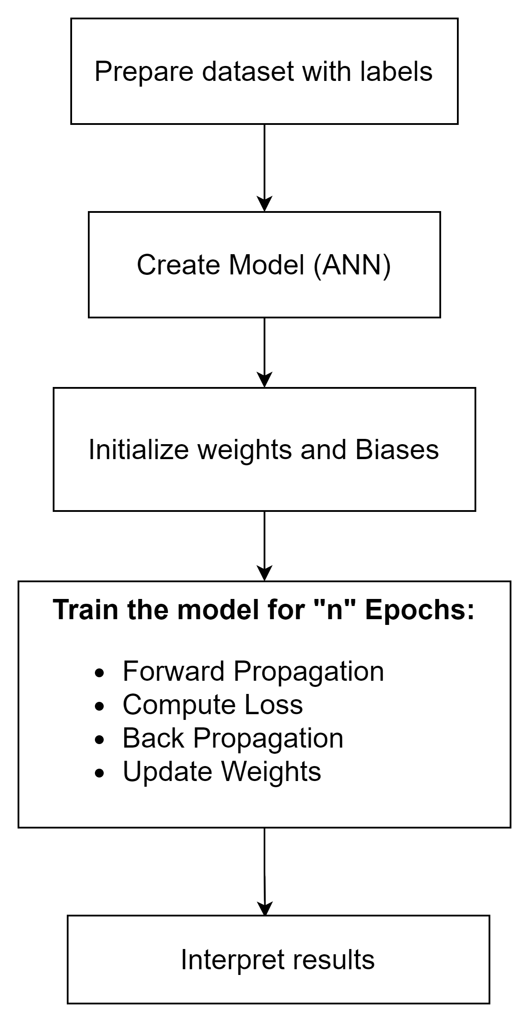
ANN Model Training Steps

